Slide 1


Fintech vaults: A secure and streamlined banking solution and services
Fintech vaults offer a comprehensive suite of secure and efficient banking services, providing customers with a seamless digital banking experience. From account management to financial planning, our platform empowers you to take control of your finances with ease.

Slide 2

Secure Access & User Management
Fintech Vaults prioritizes user security and seamless authentication. Our platform offers a secure and efficient registration process for new users, as well as convenient login options for existing customers, including biometrics and one-time codes.
User information is stored safely in our encrypted database, ensuring the privacy and protection of your personal data.

Slide 3
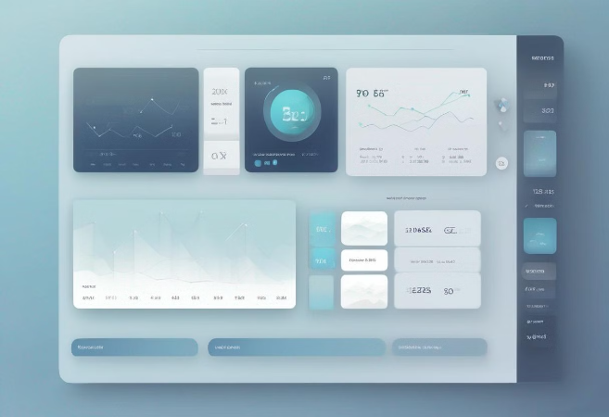
Manage Your Finances with Ease
Account Balance
Intuitive home page displaying account balance prominently.
$12,345.67
Transactions
Ability to perform various transactions
Send Money
Withdraw Funds
Deposit Funds
Receive real-time feedback on your transactions.

Slide 4
Transaction History
Search and Filter
1
Easily search and filter your transaction history by date, amount, category, or keyword to find the information you need.
2
Detailed Records
Access comprehensive details about each transaction, including the date, payee, and description, for better financial management.
Download and Export
3
Download your transaction history in various formats, such as CSV or PDF, for record-keeping or further analysis.

Slide 5
Charges Schedule
Transparent Fees
Competitive Rates
Understand the fees associated with your account, including monthly maintenance, overdraft, and other service charges.
Our fintech vaults offer competitive pricing compared to traditional banking institutions, helping you save more.
Customizable Plans
No Hidden Costs
Choose from a variety of account options and features to find the plan that best fits your financial needs and budget.
Enjoy a straightforward and transparent pricing structure, with no unexpected charges or surprise fees.

Slide 6




Privacy Policy
Data Security
Compliance
Transparency
User Control
Your personal and financial information is safeguarded by industry-leading encryption and data protection measures.
We adhere to strict regulatory standards and guidelines to ensure the privacy and security of your data.
Our privacy policy is clear and comprehensive, providing you with full visibility into how we handle your information.
You have the ability to manage your privacy preferences and choose how your data is used and shared.

Slide 7



Account Information
Personal Details
Account Settings
Linked Accounts
Update your name, address, contact information, and other personal details as needed.
Manage your account preferences, such as notification settings and password changes.
Connect your external bank accounts, credit cards, and other financial accounts for a comprehensive view.

Slide 8
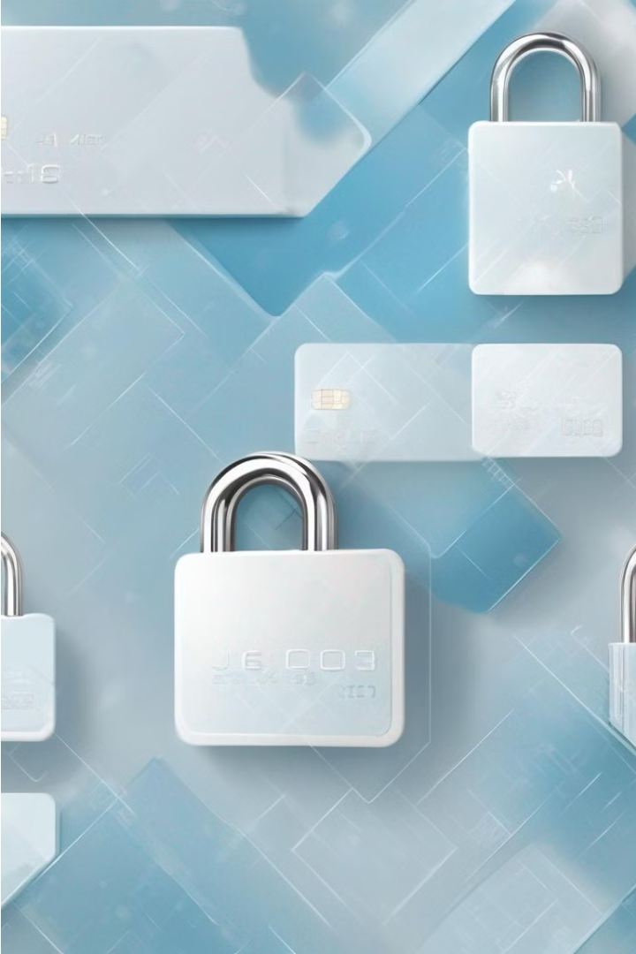
Manage Your Credit Card Securely
Dedicated section for managing credit card details.
Option to activate credit cards and set PINs for security.
Account settings for customizing user preferences.

Slide 9

Manage and Personalize Your Account
Easily customize your account experience with a variety of personalization options. Enhance the security of your account by regularly changing your password to protect your information. When you're finished, be sure to log out of your account to ensure your privacy.
Adjust your notification preferences to stay informed about important account activity, alerts, and updates. Manage your security settings, including login methods and two-factor authentication, to keep your account safe. Personalize your account further by changing the language, currency, and app theme to match your preferences.
Take control of your account and make it truly your own. With these powerful customization tools, you can tailor your fintech vault experience to meet your unique needs and preferences.

